Slide 1
Introduction to Kubernetes

Slide 2
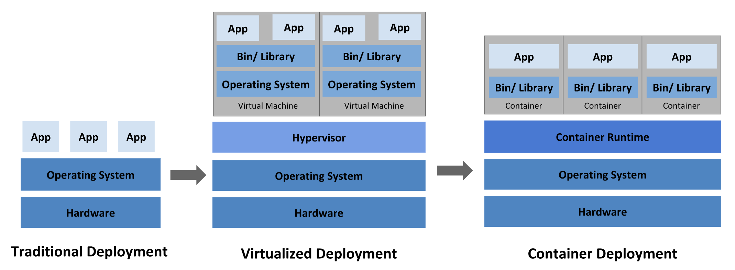
What is Kubernetes ?
Kubernetes is a vendor-agnostic cluster and container management tool, open-sourced by Google in 2014. It provides a “platform for automating deployment, scaling, and operations of application containers across clusters of hosts”.
Kubernetes is a portable, extensible, open-source platform for managing containerized workloads and services, that facilitates both declarative configuration and automation. It has a large, rapidly growing ecosystem. Kubernetes services, support, and tools are widely available.

Slide 3
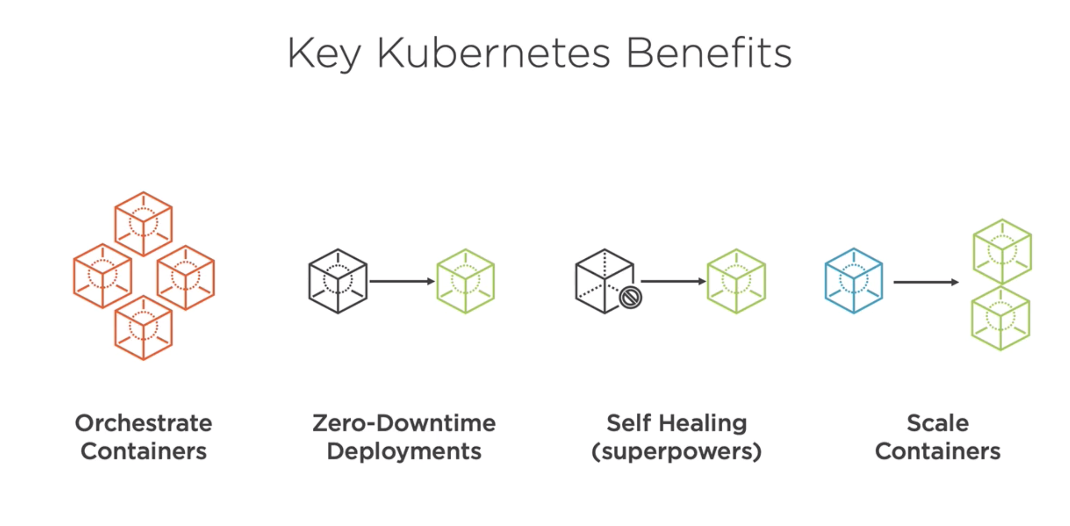
Why Kubernetes?

Slide 4
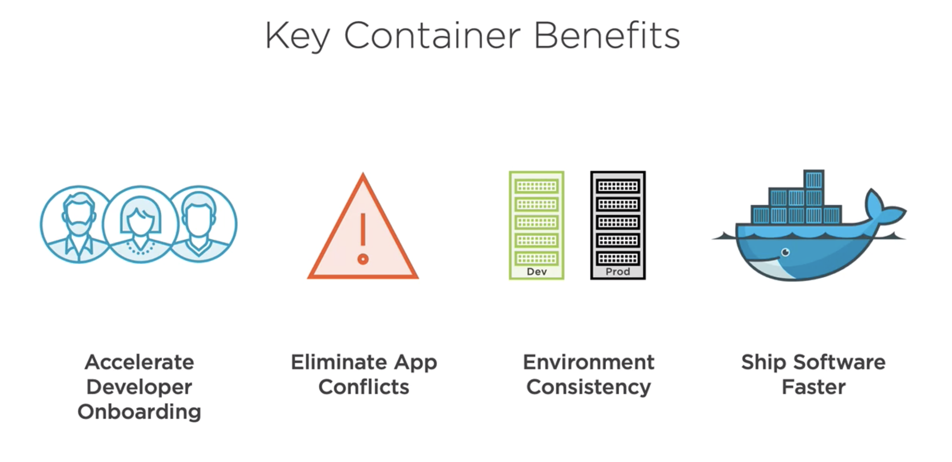

Slide 5
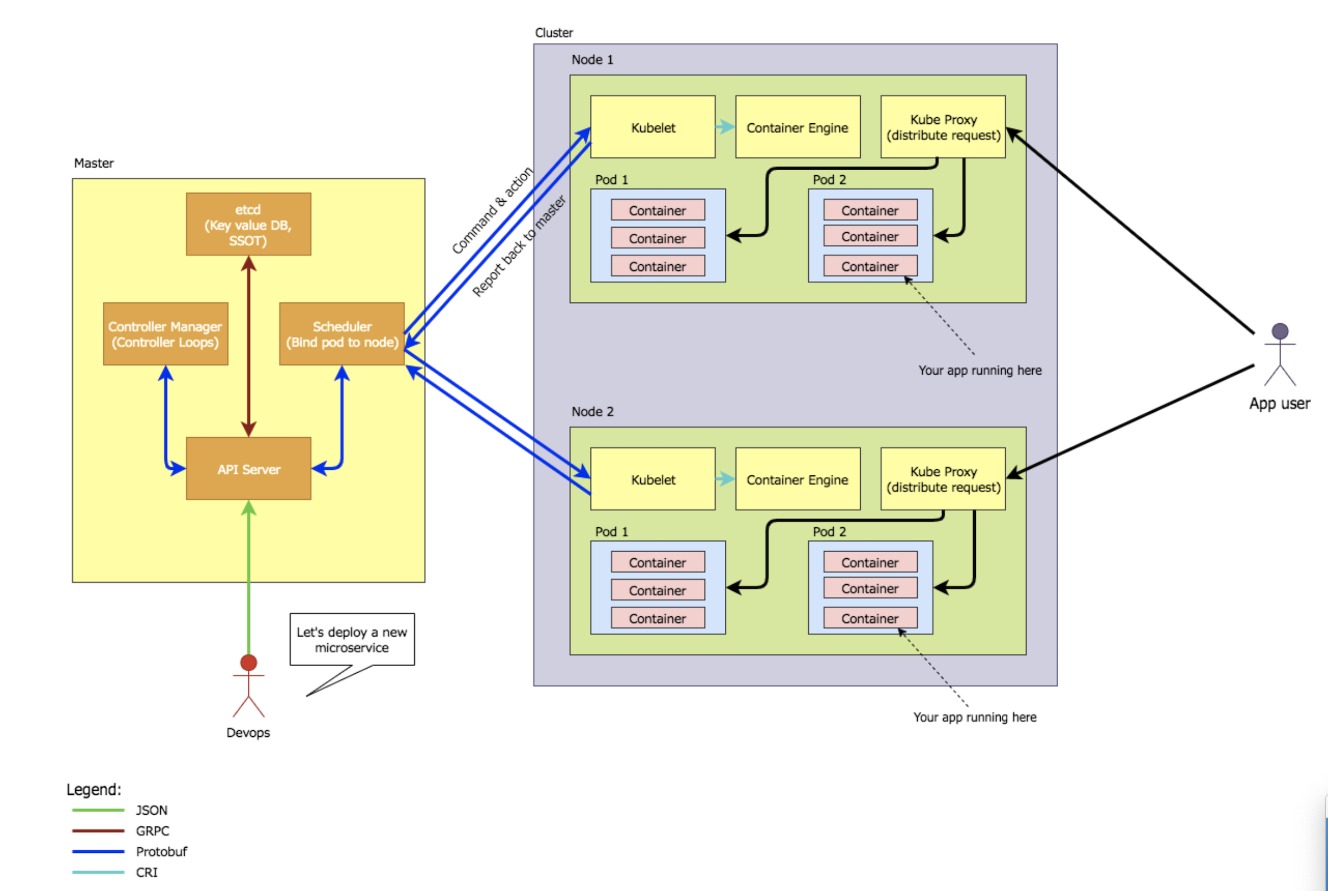
Kubernetes Architecture

Slide 6
Kubernetes Commands
kubectl config view
kubectl config get-contexts
kubectl config current-context
kubectl apply -f ./my-manifest.yaml # create resource(s)
kubectl get pods --all-namespaces
kubectl get services
kubectl logs my-pod

Slide 7
Pods

Slide 8
Pods

Slide 9
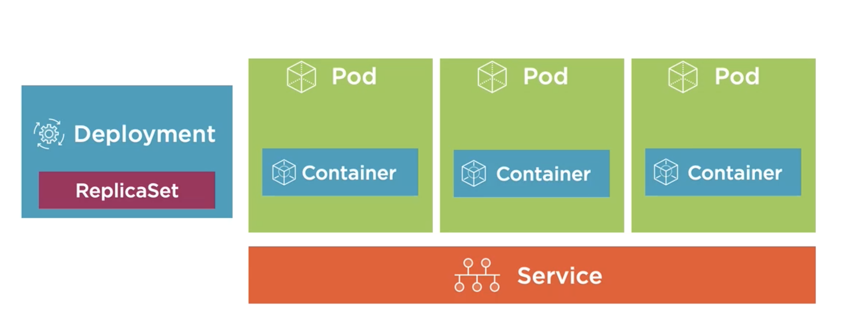
Service

Slide 10
Service Types

Slide 11
Deployments

Slide 12
Deployment

Slide 13
Thanks

Slide 14
External Service
Load Balancer Service
Node Service
ClusterIP Service

